Slide 1
Hosting a Static Website on Amazon S3 with Secure Access

Slide 3

About me

Slide 4

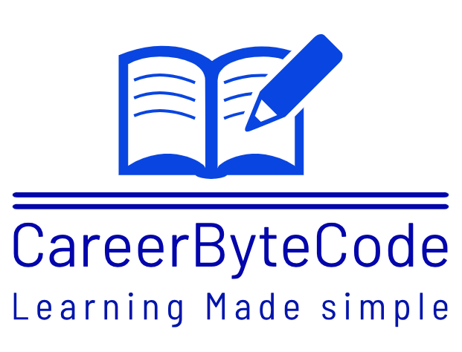






<About yout session>
<what you are going to cover >
careerbytecode
Notes:
Hello and welcome to the first section of the course. In this section we are going to learn about
Different Era and see how application were getting deployed before kubernetes.
Then we will learn about the concept of kuberenetes and why we need it
After that we will discuss about the architecture of Kuberneete and its components
Then at the last we will see the cluster setup using Kubeadm
So lets start with our topic which is deployment eras.

Slide 5

<Problem Statement>
careerbytecode
Notes:
Hello and welcome to the first section of the course. In this section we are going to learn about
Different Era and see how application were getting deployed before kubernetes.
Then we will learn about the concept of kuberenetes and why we need it
After that we will discuss about the architecture of Kuberneete and its components
Then at the last we will see the cluster setup using Kubeadm
So lets start with our topic which is deployment eras.

Slide 6

<Pre-Requisities>
careerbytecode
Notes:
Hello and welcome to the first section of the course. In this section we are going to learn about
Different Era and see how application were getting deployed before kubernetes.
Then we will learn about the concept of kuberenetes and why we need it
After that we will discuss about the architecture of Kuberneete and its components
Then at the last we will see the cluster setup using Kubeadm
So lets start with our topic which is deployment eras.

Slide 7

<Implementation Steps>
careerbytecode
Notes:
Hello and welcome to the first section of the course. In this section we are going to learn about
Different Era and see how application were getting deployed before kubernetes.
Then we will learn about the concept of kuberenetes and why we need it
After that we will discuss about the architecture of Kuberneete and its components
Then at the last we will see the cluster setup using Kubeadm
So lets start with our topic which is deployment eras.

Slide 8
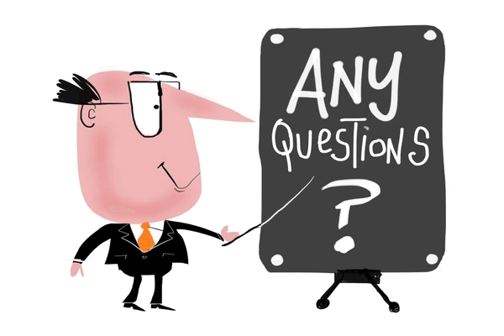
your photo
Your name
your mail id
your linkedin
careerbytecode
Notes:
Hello and welcome to the first section of the course. In this section we are going to learn about
Different Era and see how application were getting deployed before kubernetes.
Then we will learn about the concept of kuberenetes and why we need it
After that we will discuss about the architecture of Kuberneete and its components
Then at the last we will see the cluster setup using Kubeadm
So lets start with our topic which is deployment eras.

